Slide 1




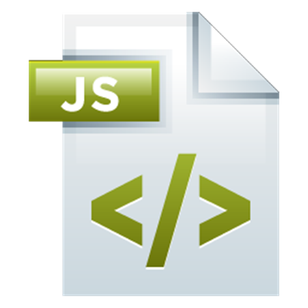
JavaScript Applications
Course Overview
Apps
JavaScript Applications
SoftUni Team
Technical Trainers
Software University
http://softuni.bg

Slide 2


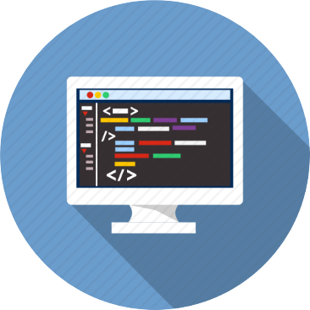
Table of Contents
Course Objectives
Course Program
Trainers Team
Course Schedule
Exams and Evaluation
Learning Resources

Slide 3
Have a Question?
sli.do #JSCORE

Slide 4










SoftUni Diamond Partners

Slide 5
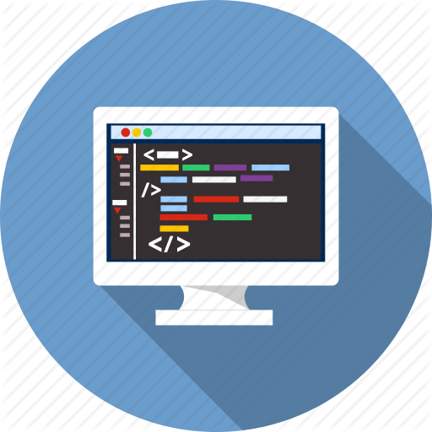
JavaScript Applications
Apps
Course Objectives & Program

Slide 6

Course Objectives
The JavaScript Applications course provides
Technologies for creating Single Page Apps (SPA)
Consuming RESTful Services (REST) with AJAX
Creating UI templates
Common JS programming patterns and routing

Slide 7
Course Topics
HTTP, REST Services, Postman
AJAX and jQuery AJAX
Asynchronous programming and promises
Creating single-page app with jQuery, AJAX, REST and Firebase
Templating: creating UI with Handlebars
Routing with Sammy.js
JS tools and libraries

Slide 8
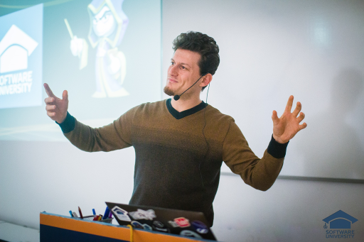
The Trainers Team

Slide 9
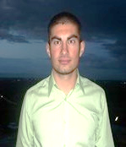
Trainers Team
Nikola Andreev
Developer @ A4Everyone
Passionate about Java and JavaScript
Experienced technical trainer
Top performing student from SotfUni

Slide 10
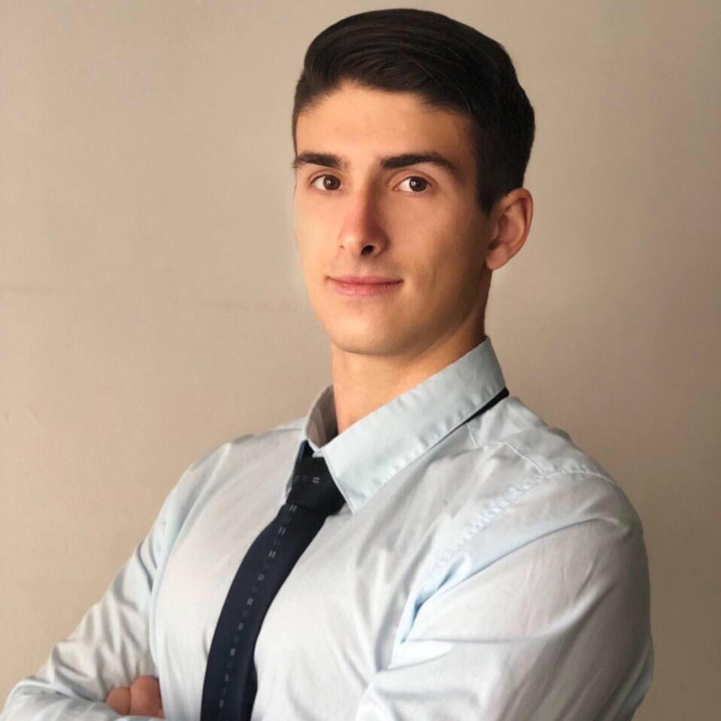
Trainers Team (2)
Martin Indzhov
Developer @ UltraPlay
Interested in Blockchain and Extreme Sports
Top performing student from SoftUni

Slide 11
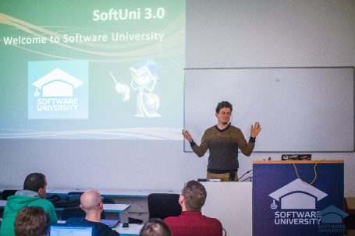


JavaScript Applications
Course Details and Schedule

Slide 12
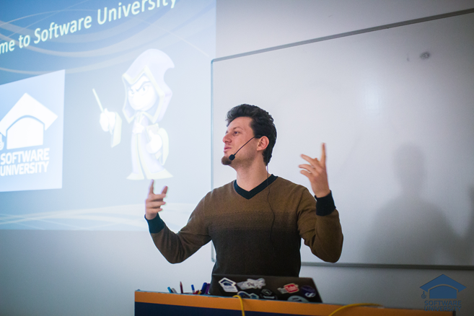
Training Duration and Schedule
Lessons: ~ 15-20 hours (onsite + YouTube videos)
Practical exercises (in class): ~ 30-40 hours
Homework: ~ 0-40 hours
Time frame
Mar – Apr 2018
Exam: 15-Apr-2018

Slide 13


Why English?
Why the slides are in English?
English is the native language of the software engineers
Specific terminology should be in English
Translations are inaccurate and funny
Just learn English!
No excuses

Slide 14


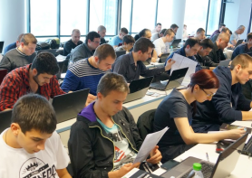
JavaScript Applications
Evaluation Criteria

Slide 15
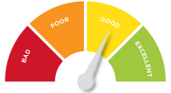

Scoring System for the Course
Mandatory:
Final exam – 90%
Homework submissions – 10%
Bonuses:
Presence in class – 5% bonus
Forum activity – bonus up to 5%

Slide 16

The Final Exam
Create a SPA (single page app)
Implement CRUD operations + login / register / logout
Use AJAX and REST + cloud-based back-end (Kinvey)
Optionally:
Use templates for rendering
Use MVC architecture + routing
AJAX
REST
Kinvey

Slide 17


Homework Assignments
Your homework is mainly work in class!
Lesson days → slides + live demos + exercises
Exercise days → only exercises
How to submit your homework?
Some submitted in the judge system
Others uploaded in the course Web site
Homework assignments are due in 7 days

Slide 18










Resources
What We Need Additionally?

Slide 19

The Programming Basics Slides and Videos
All lecture slides, videos, homework assignments, projects and other resources are open content, available for free
Visit the course web site to access the course resources

Slide 20



Recommended Software
Software needed for this course:
Noje.js – https://nodejs.org
WebStorm – https://jetbrains.com/webstorm/
Optionally:
Visual Studio Code – https://code.visualstudio.com

Slide 21
JavaScript Applications – Course Overview
https://softuni.bg/courses/

Slide 22
License
This course (slides, examples, demos, videos, homework, etc.) is licensed under the "Creative Commons Attribution-NonCommercial-ShareAlike 4.0 International" license

Slide 23





Free Trainings @ Software University
Software University Foundation – softuni.org
Software University – High-Quality Education, Profession and Job for Software Developers
softuni.bg
Software University @ Facebook
facebook.com/SoftwareUniversity
Software University Forums
forum.softuni.bg

